Slide 1
Welcome to My Presentation Name: Jannatun Ferdousi Batch:47 Roll No: 01

Slide 2
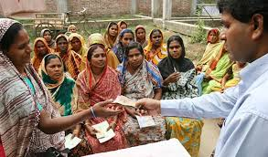
Microfinace in Bangladesh

Slide 3
Introduction
In Bangladesh there are mainly four types of institutions involved in micro-finance activities. These are:
Grameen Bank (GB), a member owned specialized institution
around 1500 Non- Governmental Organizations (NGO) like BRAC, Proshika, ASA, BURO-Tangail, BEES, CODEC, SUS, TMSS, Action- Aid etc.
Commercial and Specialized banks like Bangladesh Krishi Bank (BKB), Rajshahi Krishi Unnayan Bank (RAKUB).
Government sponsored micro finance projects/ Programs like BRDB, Swanirvar Bangladesh, RD-12 and others which are run through several ministries viz., Ministry of Women & Children Affairs, Ministry of Youth & Sports, Ministry of Social Welfare etc.

Slide 4
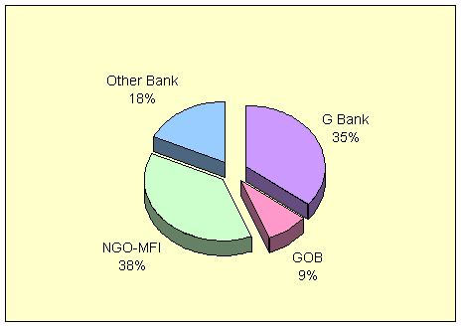
Figure-1: Institution-wise Cumulative Loan Disbursement.
some of the Private Commercial Banks (PCBs) have also started direct and linkage programs with NGOs. Total loan disbursement (cumulative) by these four kinds of institutions till December 2001 was taka 434.55 billion; of which disbursement under Government program was taka 37.77 billion (8.69%), Grameen Bank disbursed taka 154.11 billion (35.46%), other Banks and MF-NGOs disbursed taka 78.41 billion (18%) and taka 164.26 billion (37.80%) respectively (figure-1).

Slide 5
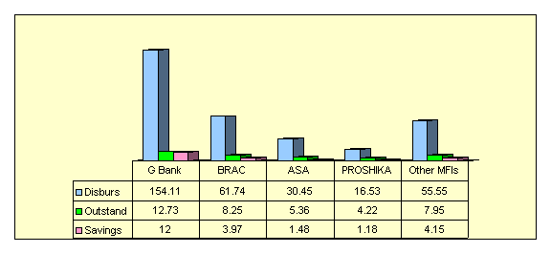
Top Four MFIs in terms of Disbursement, Outstanding loan and Savings in billion taka

Slide 6
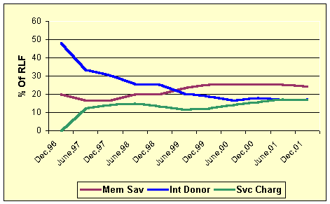
Trends of Sources of Fund over the Time.

Slide 7
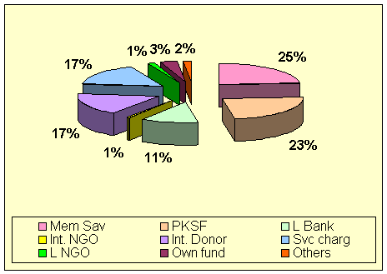
% of Revolving Loan Fund

Slide 8
Regulatory Framework
Two big provider of micro-finance are Grameen Bank and MF-NGOs. Grameen Bank follows the Grameen Bank Ordinance, 1983 and MF-NGOs register under any of the following acts of the Government of Bangladesh :
. Societies Registration Act of 1860
. Voluntary Social Welfare Agencies (Registration and Control) Ordinance of 1961
. Companies Act of 1994
. NGOs who are accepting grants

Slide 9
Challenges for MF-NGOs and for the Government
The current challenge of MF-NGOs is whether they could run the program without subsidy, because the flow of donor fund is declining over the years. Since the main objective of micro-finance is to alleviate poverty, the question is whether they would be able to charge real cost of service on the recipients.

Slide 10
Suggested Reforms To Face The Future Challenge
micro finance sector will have to develop a concrete long run vision of a flexible, self-sustainable, well-regulated and pro-people micro finance industry capable of facing all these challenges. That means the industry will:
� Design its product according to the market need - what kind of loan poor people really need and which terms and conditions are applicable to them. They should not just follow Grameen Bank model, rather they should be innovative in product designing,
� Diversify its loan portfolio, not just depending only on the agricultural sector for investment,
� Identify the exact cost involved and find out reasonable service charge for each product offered,

Slide 11
Conclusion
It is expected that with the fulfillment of the above vision this service sector would contribute to our economy by alleviating poverty in real sense. It would help to generate permanent employment, remove over dependency on agriculture and help people by eliminating their dependency on the moneylenders and informal credit suppliers. Poor people would be able to take care of their health and education by getting the benefit from this service and they would also help MFI to be sustainable by paying their due on time.

Slide 12
Thank You

